Slide 1
Title Slide
Chip Purchasing Behavior Analysis Date: 15-05-2025 Client: Quantium Setting the stage for our insights into chip buying behavior and store trial performance.

Slide 2
Agenda
Title Slide
Agenda
Project Overview
Data and Methodology
Customer Segments Overview
Sales by Customer Segment
Units Purchased per Customer
Price per Unit Analysis
Brand and Pack Size Preferences
Store Trial Performance
Recommendations
Next Steps and SummaryLet's navigate through our findings together!

Slide 3
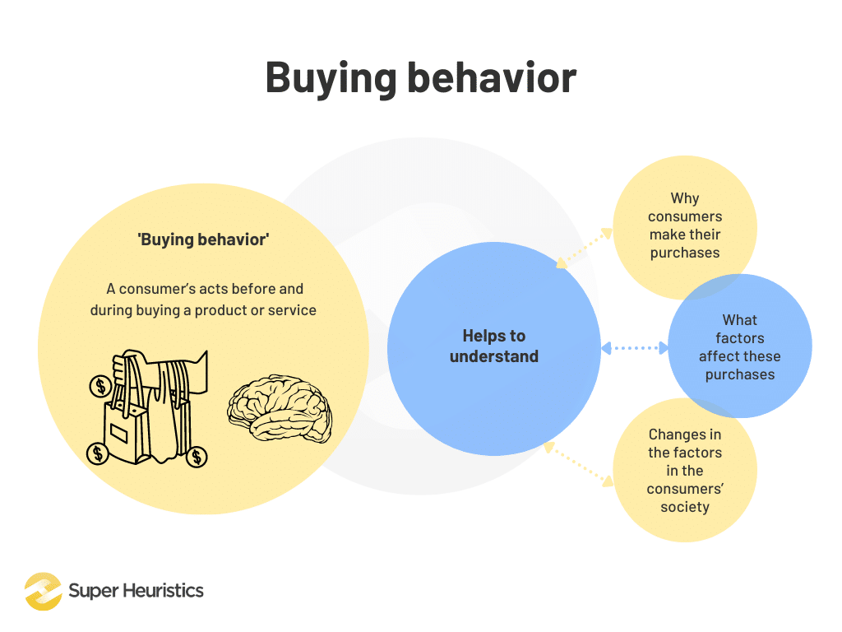
Project Overview
The purpose of this analysis is to:
Understand chip buying behavior among customers
Assess the performance of store trial initiativesOur goal is to derive actionable insights that can enhance chip sales and customer engagement.

Slide 4
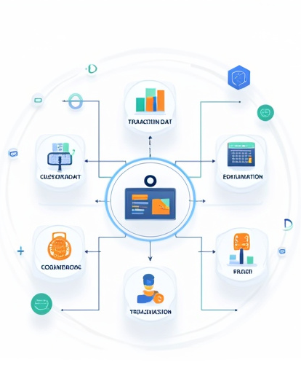
Data and Methodology
Datasets:
Transaction Data: Captures customer purchases over time
Customer Data: Provides demographic and behavioral insights
Analysis Steps:
Exploratory Data Analysis (EDA): Initial data exploration to identify trends
Segmentation: Classifying customers by Lifestage and Premium flag
Trial Comparison: Evaluating the impact of store trials on sales and customer countsThis structured approach ensures comprehensive insights.

Slide 5
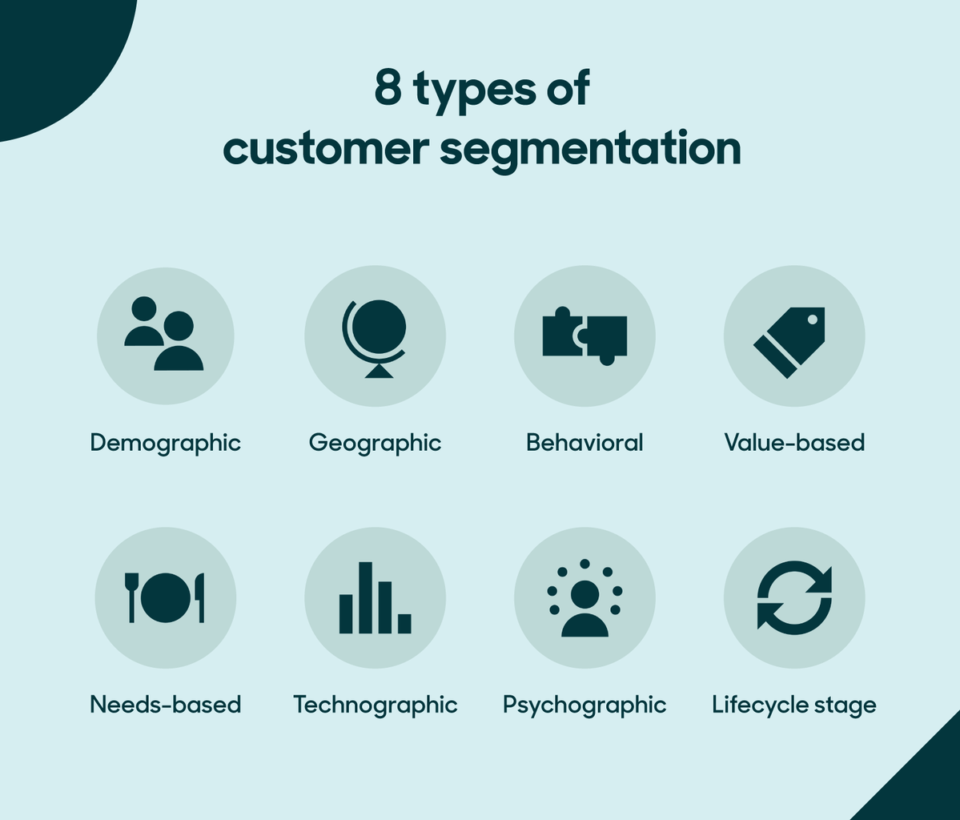
Customer Segments Overview
Segmentation by Lifestage and Premium Flag
Customers are categorized based on their life stages and whether they are premium buyers.
A stacked bar chart will illustrate the distribution of these segments. Understanding our customer segments is key to targeted marketing strategies.

Slide 6
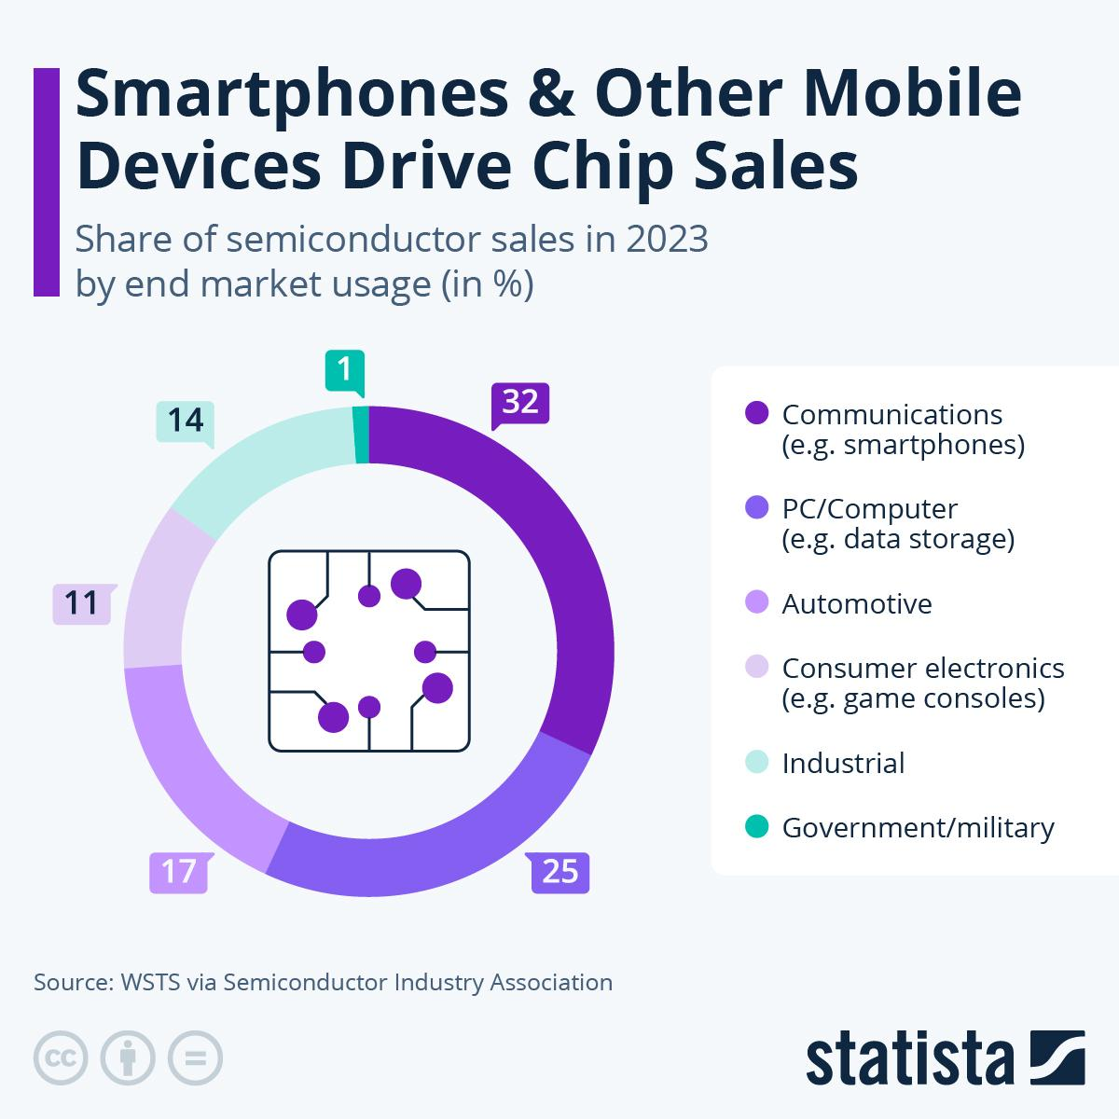
Sales by Customer Segment
Contribution to Chip Sales
A mosaic plot or horizontal bar chart will display which segments contribute most to overall chip sales. Identifying high-value segments allows for focused marketing efforts.

Slide 7
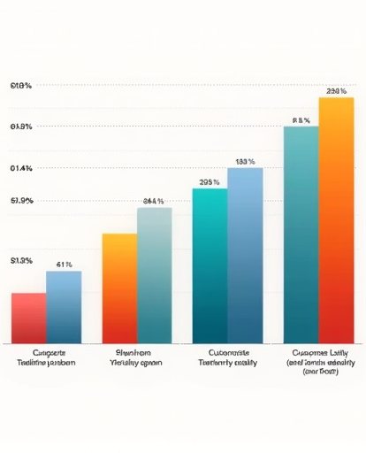
Units Purchased per Customer
Purchase Volume Differences
A grouped bar chart will highlight the differences in purchase volumes across customer segments. This insight helps in understanding customer loyalty and buying patterns.

Slide 8
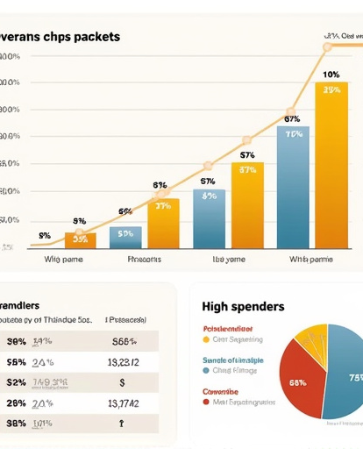
Price per Unit Analysis
Average Price per Chip Packet
Analysis of the average price spent per chip packet across segments, with an emphasis on high spenders. Understanding pricing dynamics is crucial for competitive positioning.

Slide 9
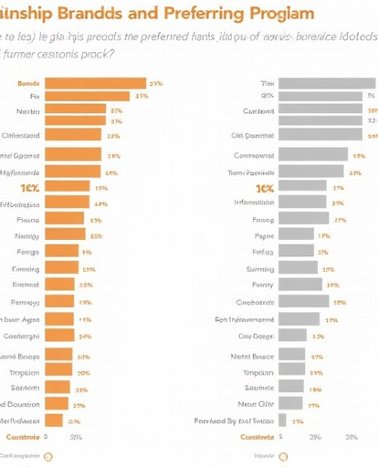
Brand and Pack Size Preferences
Preferences by Target Segments
Side-by-side charts will showcase the top brands and preferred pack sizes for each customer segment. This information is vital for inventory and marketing strategies.

Slide 10
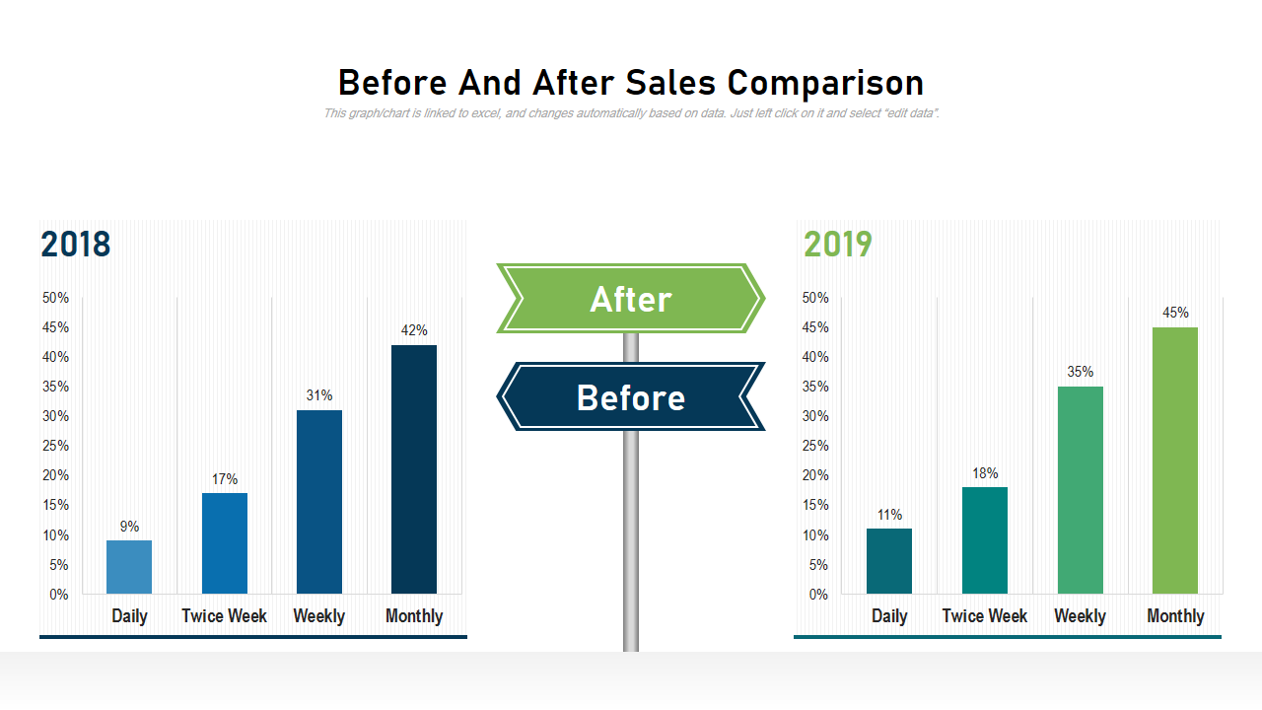
Store Trial Performance
Comparing Sales and Customer Counts
Line plots will compare sales and customer counts between trial and control stores. Evaluating trial performance helps in assessing the effectiveness of initiatives.

Slide 11

Recommendations
Actionable Items:
Product Placement: Optimize shelf space for high-demand segments
Segment Targeting: Tailor promotions to specific customer segments
Brand Focus: Prioritize top-performing brands in marketing effortsThese recommendations are designed to enhance sales and customer satisfaction.

Slide 12
Next Steps and Summary
Key Takeaways:
Insights into chip purchasing behavior and customer segments
Evaluation of store trial performance
Actionable recommendations for future strategiesPropose next actions to implement findings and improve chip sales.
Date: 15-05-2025

